Slide 1



Finite Element Analysis
Term Paper project on
Space Truss Analysis using MATLAB
Guided by:- Prof. S.A. Sannasiraj
OE23M030 Vikash Chand Sharma
OE23M024 Amit Pawar
OE23M021 Shubham Singh
Department of Ocean Engineering,
Indian Institute of Technology Madras

Slide 2
Problem Statement
Space trusses are essential structural elements widely used in engineering applications for supporting loads in various structures. In this term paper, we focus on the analysis of a specific space truss configuration comprising three members hinged at points anchored to a wall. The coordinates of the hinged points are as follows: Point 2 (50, 30, 0), Point 3 (0, 40, 80), and Point 4 (0, 0, 60), with all three members converging at Point 1 (40, 24, 0).
The truss is subjected to a boundary condition where all support displacements are constrained to be zero, reflecting the rigid attachment of the truss members to the wall.
Force applied at node 1 only in x-direction whose magnitude is 12kN.
The objective of this study is to perform a comprehensive analysis of the given space truss configuration, considering factors such as member forces, displacements, and reactions. Through this analysis, we aim to gain insights into the structural behavior and stability of the truss under various loading conditions.

Slide 3
Methodology
Discretization of the structure
Apply boundary conditions
Find unknown displacements using Gauss elimination method
Find stress and strain on each member
Nodes and elements numbering
Identify material behaviour (E,A)
Assemble stiffness matrix
Element stiffness matrix (K)
Finding reaction

Slide 4
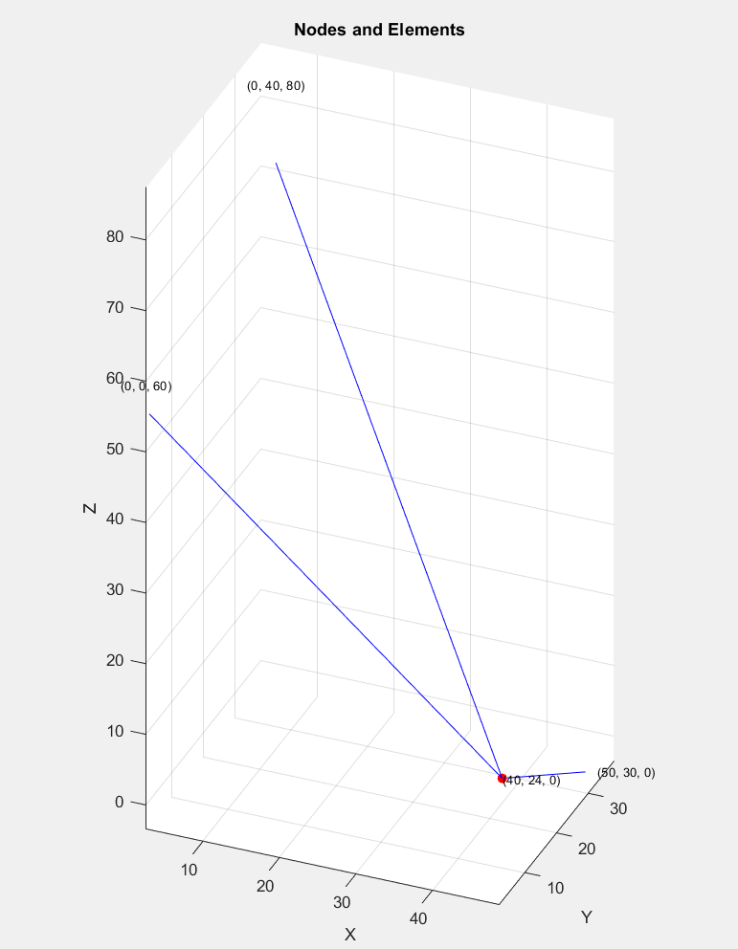
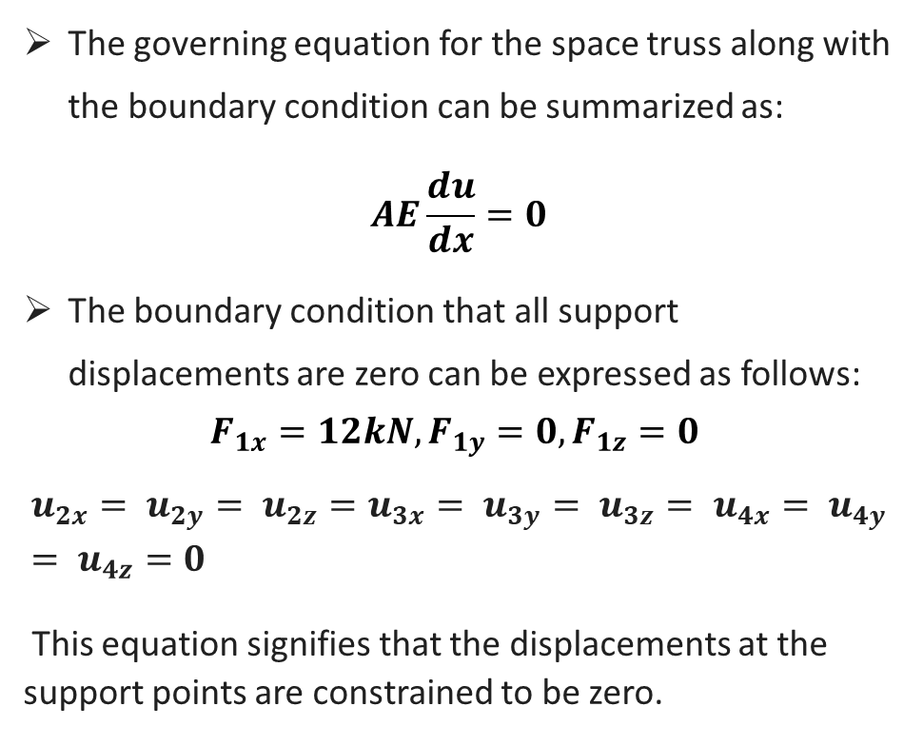
Boundary condition and governing equation
The governing equation for the space truss along with the boundary condition can be summarized as:
$$AE\frac{du}{dx}=0$$
The boundary condition that all support displacements are zero can be expressed as follows:
$$F_{1x}=12kN, F_{1y}=0, F_{1z}=0$$
$$u_{2x}= u_{2y}= u_{2z}=u_{3x}= u_{3y}= u_{3z}= u_{4x}= u_{4y}= u_{4z}=0$$
This equation signifies that the displacements at the support points are constrained to be zero.
3
4
2
1

Slide 5
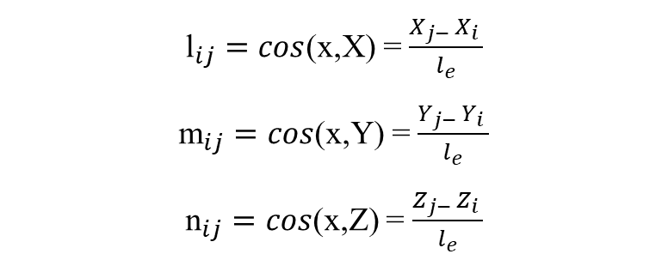
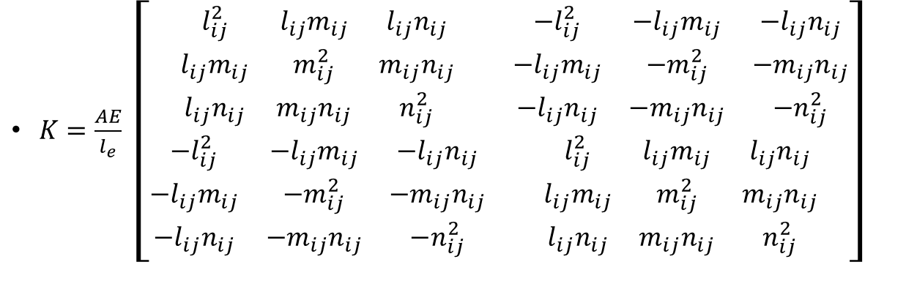
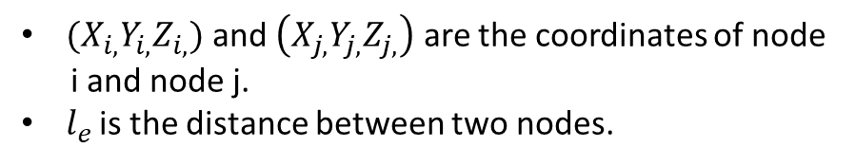
Local stiffness matrix
${(X}_{i,}Y_{i,}Z_{i,})$ and $\left(X_{j,}Y_{j,}Z_{j,}\right)$ are the coordinates of node
i and node j.
$l_{e }$is the distance between two nodes.
${\text{l}}_{ij}=cos$(x,X) = $\frac{X_{j− }X_{i }}{l_{e}}$
${\text{m}}_{ij}=cos$(x,Y) = $\frac{Y_{j− }Y_{i }}{l_{e}}$
${\text{n}}_{ij}=cos$(x,Z) = $\frac{Z_{j− }Z_{i }}{l_{e}}$
$K=\frac{AE}{l_{e}} \left[\begin{matrix}\begin{matrix}l_{ij}^{2} & l_{ij}m_{ij} & l_{ij}n_{ij} \\ l_{ij}m_{ij} & m_{ij}^{2} & m_{ij}n_{ij} \\ l_{ij}n_{ij} & m_{ij}n_{ij} & n_{ij}^{2}\end{matrix} & \begin{matrix}{−l}_{ij}^{2} & {−l}_{ij}m_{ij} & −l_{ij}n_{ij} \\ {−l}_{ij}m_{ij} & −m_{ij}^{2} & −m_{ij}n_{ij} \\ {−l}_{ij}n_{ij} & {−m}_{ij}n_{ij} & −n_{ij}^{2}\end{matrix} \\ \begin{matrix}−l_{ij}^{2} & −l_{ij}m_{ij} & −l_{ij}n_{ij} \\ {−l}_{ij}m_{ij} & −m_{ij}^{2} & −m_{ij}n_{ij} \\ {−l}_{ij}n_{ij} & −m_{ij}n_{ij} & −n_{ij}^{2}\end{matrix} & \begin{matrix}l_{ij}^{2} & l_{ij}m_{ij} & l_{ij}n_{ij} \\ l_{ij}m_{ij} & m_{ij}^{2} & m_{ij}n_{ij} \\ l_{ij}n_{ij} & m_{ij}n_{ij} & n_{ij}^{2}\end{matrix}\end{matrix}\right]$

Slide 6
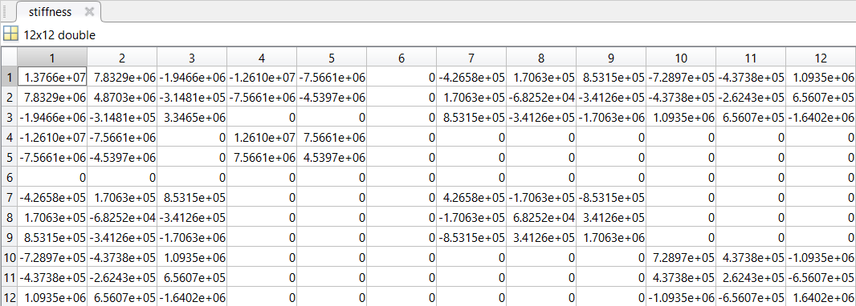
Global stiffness Matrix

Slide 7
REFERENCES
FEM Classnotes By Prof. S A Sannasiraj
MATLAB Guide to Finite Elements: An Interactive Approach By Peter I. Kattan
DaryILogan - A First Course In The Finite Element Method

Slide 8
Thank you

